Slide 1


http://pingo.edu.vn/khoa-hoc-php-can-ban/
PHP Basics – Functions - Forms
Web Applications in Hatch
Tuan Duong
http://pingo.edu.vn/tuan-duong/

Slide 2
Contents
Functions
Include/require
Forms
How forms work
How to write forms in XHMTL
How to access the data in PHP

Slide 3
PHP Functions - Problem
Given an array with 100 elements are random numbers.
- Display the sum of elements from 10 to 20.
- Display the sum of elements from 24 to 38
- Display the sum of elements from 12 to 99
Issue: How to resolve duplicated problems?

Slide 4
Code Re-use
Option you will want to write a piece of code and re-use it several times (maybe within the same script, or maybe between different scripts).
Functions are a very nice way to encapsulate such pieces of code

Slide 5
PHP Functions
Definition:
PHP functions are similar to other programming languages. A function is a piece of code with takes one more input in the form of parameter and does some processing and returns a value.
You already have seen many functions like fopen() or fclose() etc. They are built-in functions but PHP gives you option to create your own functions as well.

Slide 6
PHP Functions
There are two types of functions
Build-in functions
User defined functions
There are two parts which should be clear to you
Creating a PHP Function
Calling a PHP Function

Slide 7
Creating PHP Function
Note that while creating a function its name should start with keyword function and all the PHP code should be put inside { and } braces

Slide 8
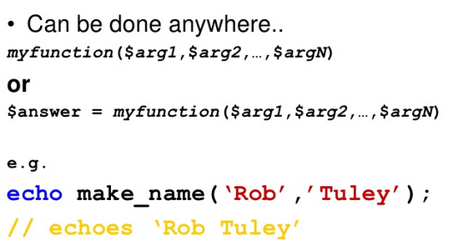
Call PHP Function

Slide 9
PHP Function
Example
<html>
<head>
<title>Writing PHP Function</title>
</head>
<body>
<?php
/*
* Defining a PHP Function
*/
function writeMessage() {
echo "Here is a message.";
}
/*
* Calling a PHP Function
*/
writeMessage();
?>
</body>
</html>

Slide 10
PHP Functions with Parameters
PHP gives you option to pass your parameters inside a function. You can pass as many as parameters you like. These parameters work like variables inside your function

Slide 11
PHP Functions with Parameters
<html>
<head>
<title>Writing PHP Function</title>
</head>
<body>
<?php
/*
* Defining a PHP Function
*/
function addTwoNumbers($num1, $num2) {
$num = $num1 + $num2;
echo "Sum of the two numbers is: " . $num;
}
/*
* Calling a PHP Function
*/
addTwoNumbers(10, 25);
?>
</body>
</html>

Slide 12
PHP Functions with Parameters
<?php
function familyName($name, $year) {
echo "Name of person is {$name}. Born in {$year}";
}
familyName("Zeesan Ahmed", "1993");
familyName("Bill Gates", 1959);
familyName("Sony Ericsson", "1900");
?>

Slide 13
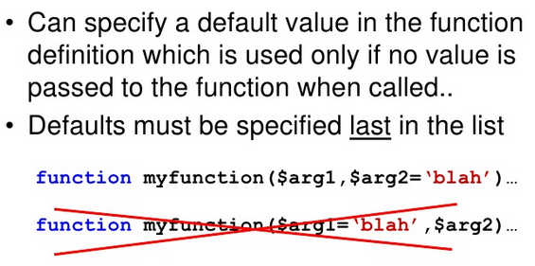
PHP Default Parameter Value

Slide 14
PHP Default Parameter Value
If we call the function setHeight() without parameters. It will tak the default value as parameter.
<?php
function setHeight($height = 100) {
echo "The height is : {$height} <br />";
}
setHeight(200);
setHeight(); // Will use the default value of 100
setHeight(1000);
setHeight("I don't know");
?>

Slide 15
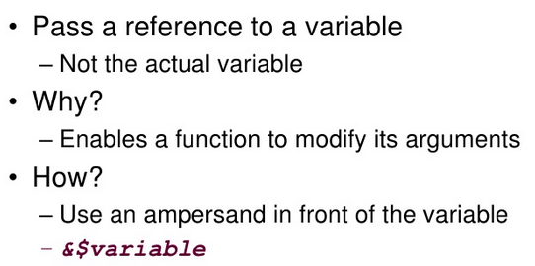
Passing Reference

Slide 16
PHP Functions returning value
A function can return a value using the return statement in conjunction with a value or object. Return stops the excution of the function and sends the value back the calling code. Meaning you should have a variable to hold the returned value of the function.

Slide 17
PHP Functions returning value
<html>
<head>
<title>Writing PHP Function</title>
</head>
<body>
<?php
/*
* Defining a PHP Function
*/
function addTwoNumbers($num1, $num2) {
$num = $num1 + $num2;
return $num;
}
/*
* Calling a PHP Function
*/
$returnedNum = addTwoNumbers(10, 25);
echo "Sum of the two numbers is: " . $returnedNum;
?>
</body>
</html>

Slide 18
Notes
Function can be called before or after its definition.
It’s error if calling non-existent function.
Non-existent function means the function that is defined within script executing.
A function name can start with a letter or underscore, not a number.
The function names are case-insensitive.
You can add as many parameters (also called as arguments) as you want, just separate them with a comma.

Slide 19
Example
<?php
func1();
function func1() {
echo "This is the message showed in function 1 <br />";
}
func1();
func2(); // Error; call to non-existent function
$flag = true;
if ($flag) {
function func2() {
echo "This is the message showed in function 2 <br />";
}
}
if ($flag) {
func2();
}
function func3() {
function func3_1() {
echo "This is the message showed in function 1 of function 3";
}
}
funct3_1(); // Error; call to non-existent function
func3(); // Ok, now the func3_1() exists
func3_1(); // So we can call it now
?>

Slide 20
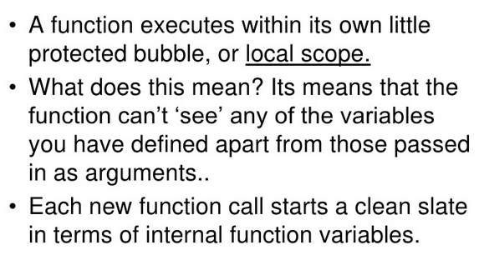
Scope

Slide 21
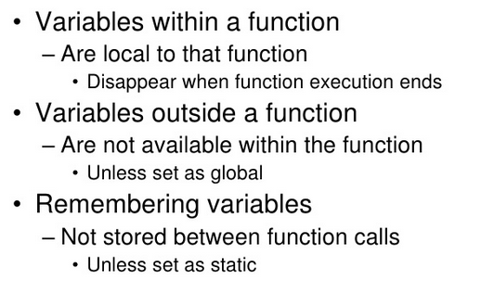
Scope

Slide 22
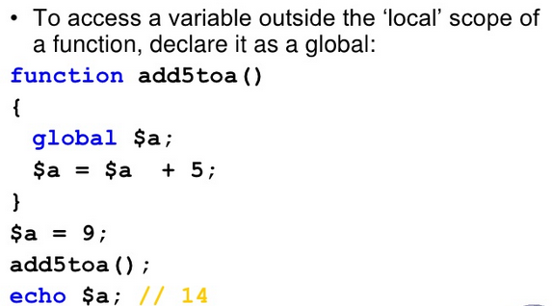
Global variables

Slide 23
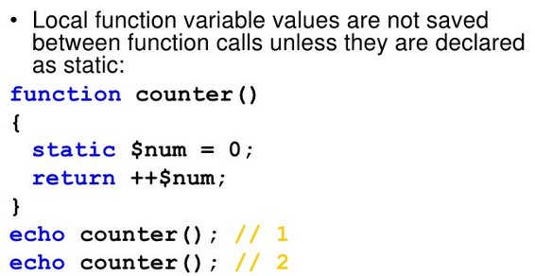
Static variables

Slide 24
require - include
require('filename.ext');
Includes and evaluates the specified file
Error is fatal (will halt processing)
include('filename.ext’)
Includes and evaluates the specified file
Error is a warning (processing continues)
require_once/include_once
If already included somewhere, it won’t be included again.

Slide 25
require/include
test1.php
<?php
echo "This is test1.php file";
?>
test2.php
<?php
include("test1.php");
?>

Slide 26
Forms
How forms work
How to write forms in XHMTL
How to access the data in PHP

Slide 27
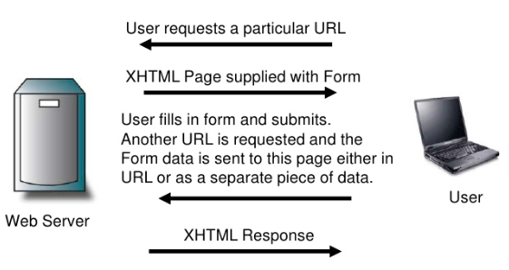
How forms work

Slide 28
XHTML Form
The form is enclosed in <form> tags
<form
action="path/to/submit/page"
method="get">
<!-- Form content here -->
</form>

Slide 29
Form tags
action="" is the page that the form should submit its data to.
method="" is the method by which the form data is submitted. The option are either get or post. If the method is get the data is passed in the url string, if the method is post it is passed as a separate file.

Slide 30
Form fields: text input
Use a text input within form tags for a single line freeform text input
<label for="firstname">First Name</label>
<input
type="text"
name="firstname"
id="firstname"
size="20" />

Slide 31
Form fields: text input
name="" is the name of the field. You will use this name in PHP to access the data.
id="" is label reference string – this should be the same as that referenced in the <label> tag.
size="" is the length of the displayed text box (number of characters).

Slide 32
Form fields: password input
Use a starred text input for passwords
<label for="pw">Password</label>
<input
type="password"
name="psword"
id="pw"
size="20" />

Slide 33
Form fields: textarea
If you need more than line to enter data, use a textarea
<label for="desc">Description</label>
<textarea
name="description"
id="desc"
rows="15" cols="30" >
Default text goes here...
</textarea>

Slide 34
Form fields: textarea
name="" is the name of the field. You will use this name in PHP to access the data.
id="" is label reference string – this should be the same as that referenced in the <label> tag.
rows="" cols="" is the size of the displayed text box

Slide 35
Form fields: dropdown
If you need more than line to enter data, use a textarea
<label for="tn">Where do you live?</label>
<select name="town" id="tn">
<option value="hochiminh">Ho Chi Minh</option>
<option value="danang" selected="selected">Da Nang</option>
<option value="hanoi">Ha Noi</option>
</select>

Slide 36
Form fields: dropdown
name="" is the name of the field
id="" is label reference string
rows="" cols="" is the size of the displayed text box
<option value="..." is the actual data sent back to PHP if the option is selected.
<option>…</option> is the value displayed to the user.
selected="selected" this option is selected by default.

Slide 37
Form fields: radio buttons
<input
type="radio"
name="age"
id="u30"
checked="checked"
value="under30" />
<label for="u30">Under 30</label>
<br />
<input
type="radio"
name="age"
id="thirty40”
value="30to40" />
<label for="thirty40">30 to 40</label>

Slide 38
Form fields: radio buttons
name="" is the name of the field. All radio boxes whit the same name are grouped with only one selectable at a time
id="" is label reference string
value="" is the actual data send back to PHP if the option is selected
selected="selected" this option is selected by default.

Slide 39
Form fields: checkboxes
What colours do you like? <br />
<input
type="checkbox"
name="colour[]"
id="r"
checked="checked"
value="red" />
<label for="r">Red</label>
<br />
<input
type="checkbox"
name="colour[]"
id="b"
value="blue" />
<label for="b">Blue</label>

Slide 40
Form fields: checkboxes
name="" is the name of the field. Multiple checkboxes can be selected, so if the checkbox are given the same name, they will overwrite previous values. The exception is if the name is given with square brackets – an array is returned to PHP
id="" is label reference string
value="" is the actual data send back to PHP if the option is selected
checked="checked" this option is selected by default.

Slide 41
Form fields: Hidden fields
<input
type="hidden"
name="hidden_value"
value="My hidden value" />
name="..." is the name of the field
value="..." is the actual data send back to PHP.

Slide 42
Submit button
A submit button for the form can be created with the code
<input
type="submit"
name="submit"
value="Submit" />

Slide 43
In PHP
The form variables are available to PHP in the page to which they have been submitted.
The variables are available in two superglobal arrays created by PHP called $_POST and $_GET

Slide 44
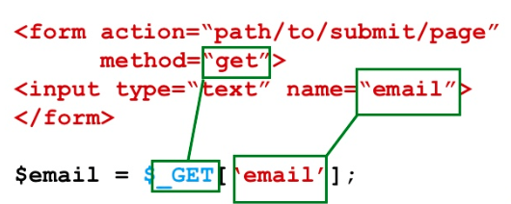
Access data from PHP
Access submitted data in the relevant array for the submission type, using the input name as a key.

Slide 45
Warning!!!
Always check what has been input.
Validation can be undertaken using Regular expressions or build-in PHP functions.
You can define your validation functions to validate data.

Slide 46
Is it submitted?
We also need to check before accessing data to see if the data is submitted, use isset() function.
<?php
if (isset($_POST['username'])) {
// Perform form processing including validation...
}
?>

Slide 47
Practice
How to redisplay the form after submitting?

Slide 48
PHP Basics - Strings

